Slide 1
Big Data Analysis on car Crashes Reported in Montgomery County
Eddy Zhang
George Mason University
AIT614 – Big Data Essentials
Team 1: Zeeshan Khalid Dhanya Akhila Peiran Li Siddharth

Slide 2
Background
Road safety stands as one of the top concerns, with vehicle related accident posing significant risks to both life and property
Fatal car crash has been increasing signaficantly – 36,835 in 2018 to 42,795 in 2022
Totaled $340 billion economic costs in 2019
In this project, we will dive into the car accident data collected by Montegomery County, Maryland to identify the trends of car crash in this region and provide preventation stragety.

Slide 3
Objective
Main Objective:
Focus on key features integral to understand car crashes in Montgomery County.
Develop a predictive model to identify primary factors contributing to driver-at-fault incidents.
Best Outcome:
Uncover insights into root causes of car crashes.
Enable targeted interventions and preventive measures for road safety enhancement.

Slide 4
Proposed Data set
Dataset Summary:
Title: Crash Reporting - Drivers Data
Data Provider: Montgomery County, MD
Update Frequency: Weekly
Last Updated: February 9, 2024
Dataset Description:
The dataset provides information on motor vehicle operators (drivers) involved in traffic collisions occurring on county and local roadways within Montgomery County, Maryland. The data is collected through the Automated Crash Reporting System (ACRS) of the Maryland State Police and reported by various law enforcement agencies including the Montgomery County Police, Gaithersburg Police, Rockville Police, or the Maryland-National Capital Park Police.
Dataset Characteristics:
• Data points: 172,000
• Data Features: 43

Slide 5

Data Analytics Methods
Preprocessing:
Clean and normalize data.
Encode categorical variables.
Exploratory Data Analysis (EDA):
Conduct statistical analysis.
Visualize data distributions and relationships.
Geospatial Analysis:
Identify hotspots on a map.
Feature Engineering:
Extract time and location-based features.
Aggregate data for summary insights.
Predictive Modeling:
Apply classification or regression models based on the problem.
Models Matrix evaluation
Report:
Create reports and dashboards.

Slide 6
Technologies
NoSQL database – Mongodb
Big data Engines - Pyspark for data preprocessing and MLib for Feature Engineering and Machine learning algorithms.
Big Data Platforms: Databricks and Jupyter Notebook

Slide 7
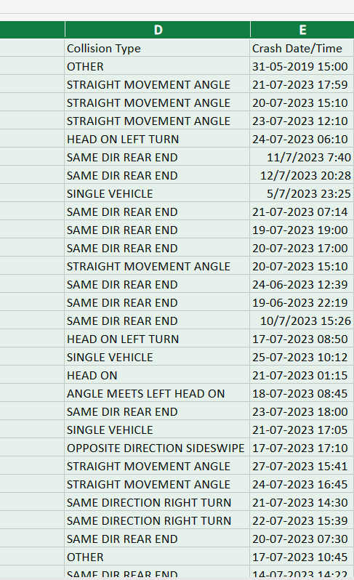
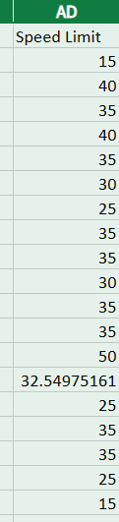
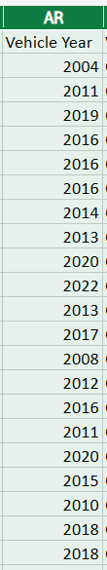
Data Cleaning and Preprocessing Outputs
Data cleaning:
split date and time columns
Replace 0 speed limit with mean values
Replace 0 vehicle years with mode values

Slide 8

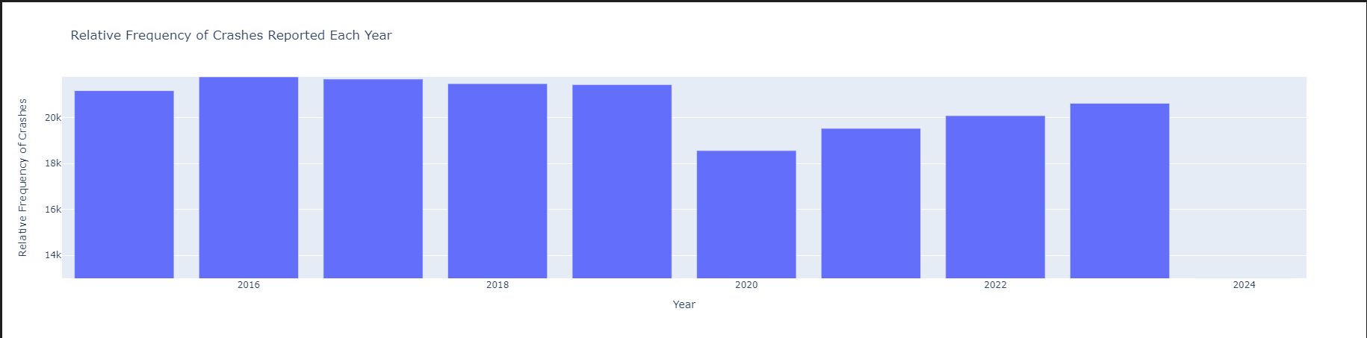
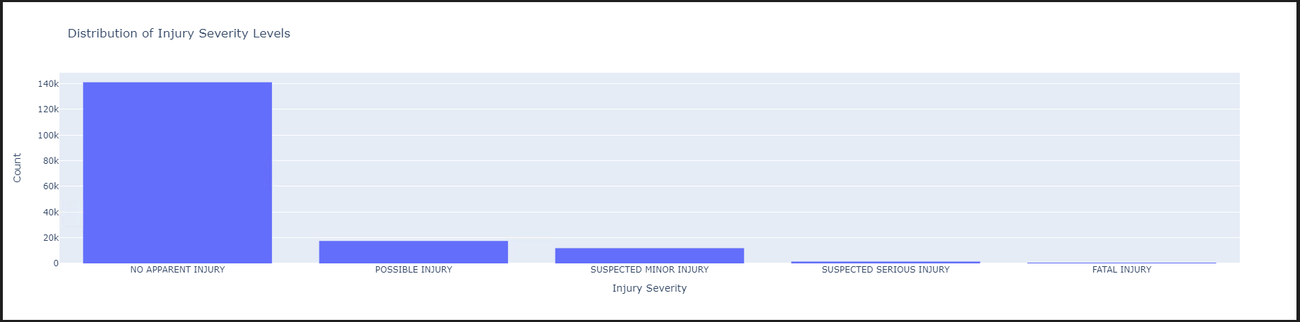
Exploratory Data Analysis

Slide 9
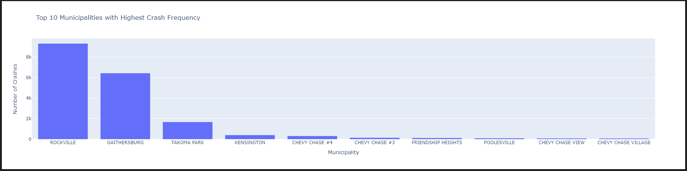
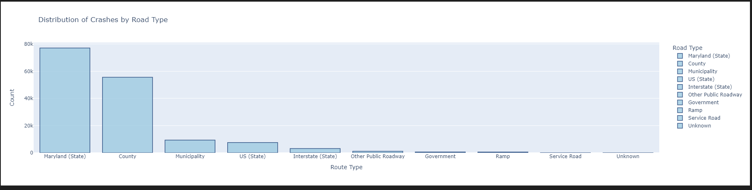

Slide 10
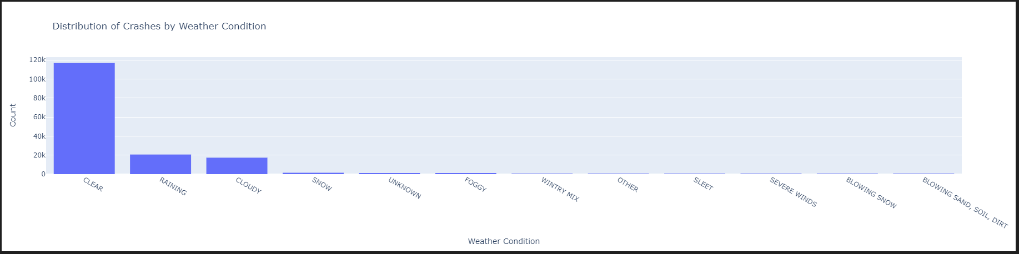
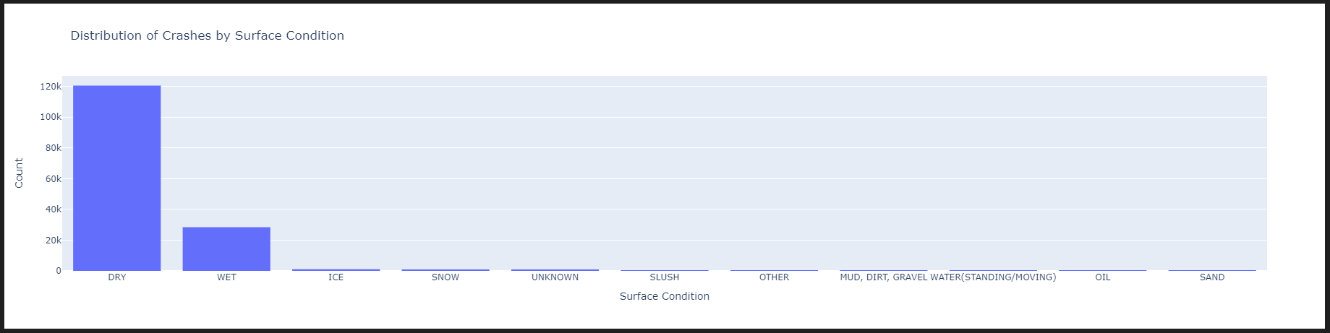

Slide 11
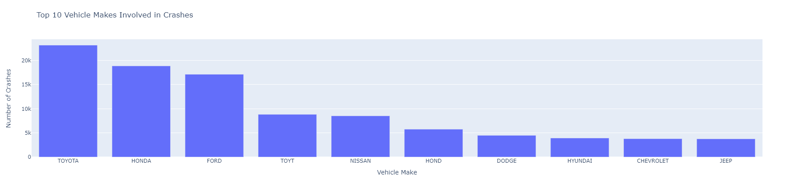

Slide 12
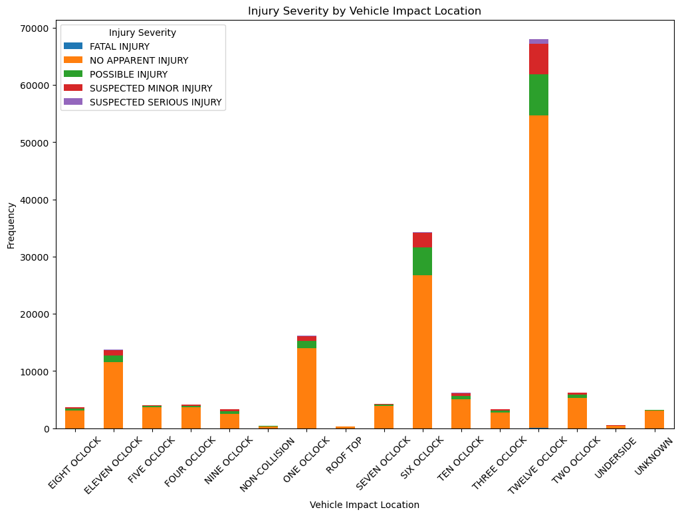

Slide 13
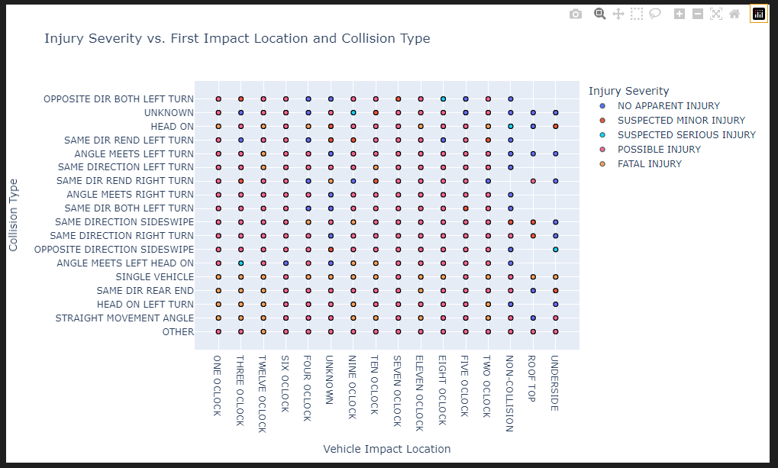

Slide 14
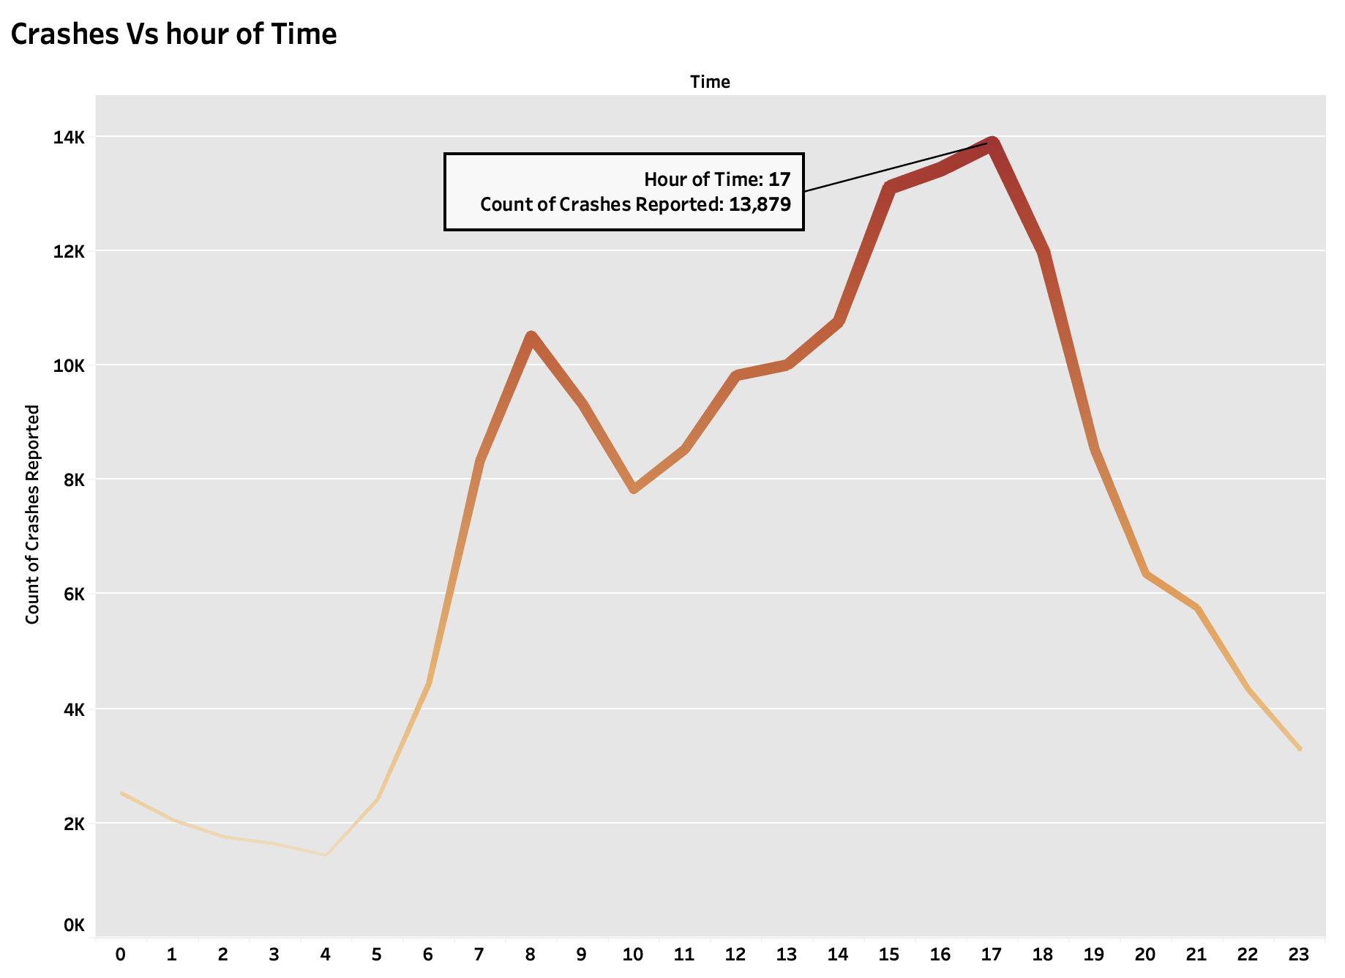
How does the frequency of car crashes vary throughout the day ?
Notes:
How does the frequency of car crashes vary throughout the day ?

Slide 15
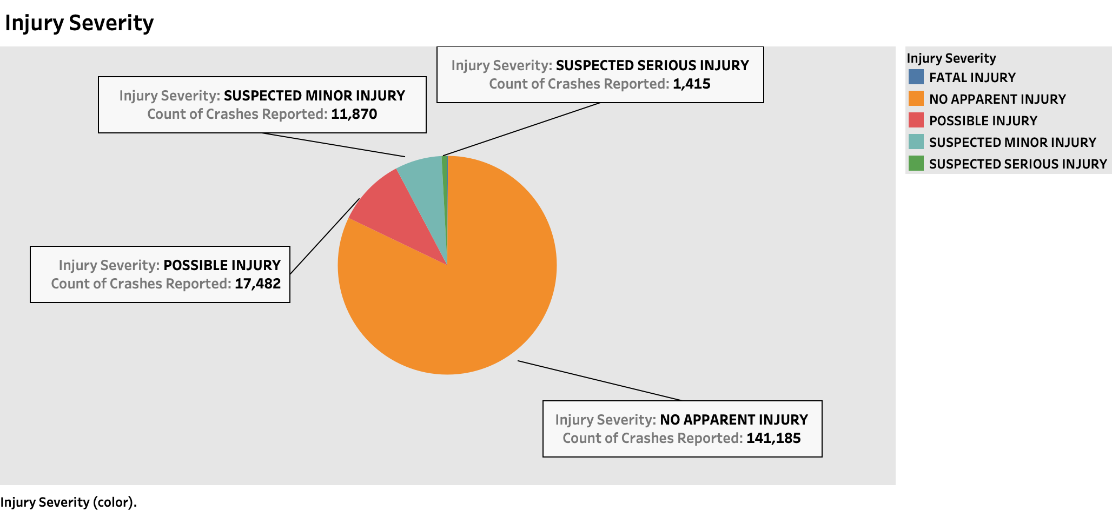
What proportion of injuries fall into different severity categories?
Notes:
What proportion of injuries fall into different severity categories?

Slide 16
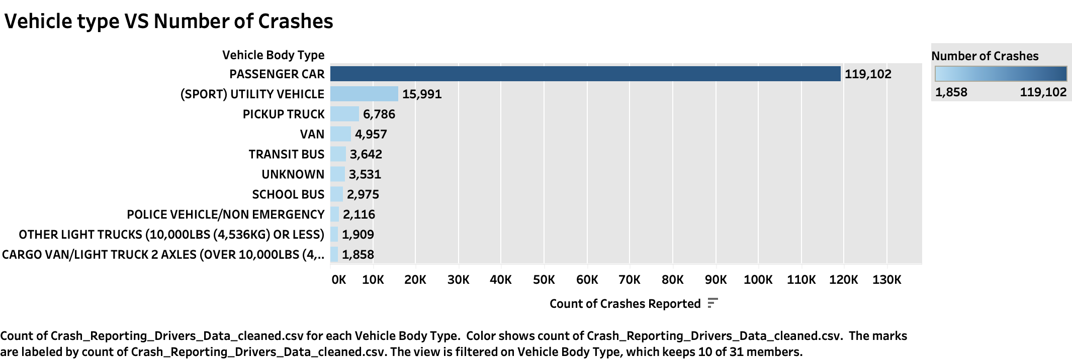
Which top vehicles are most frequently involved in crashes and how many of these crashes are attributed to driver fault?
Notes:
Which top vehicles are most frequently involved in crashes and how many of these crashes are attributed to driver fault?
Which top vehicles are most frequently involved in crashes and how many of these crashes are attributed to driver fault?

Slide 17
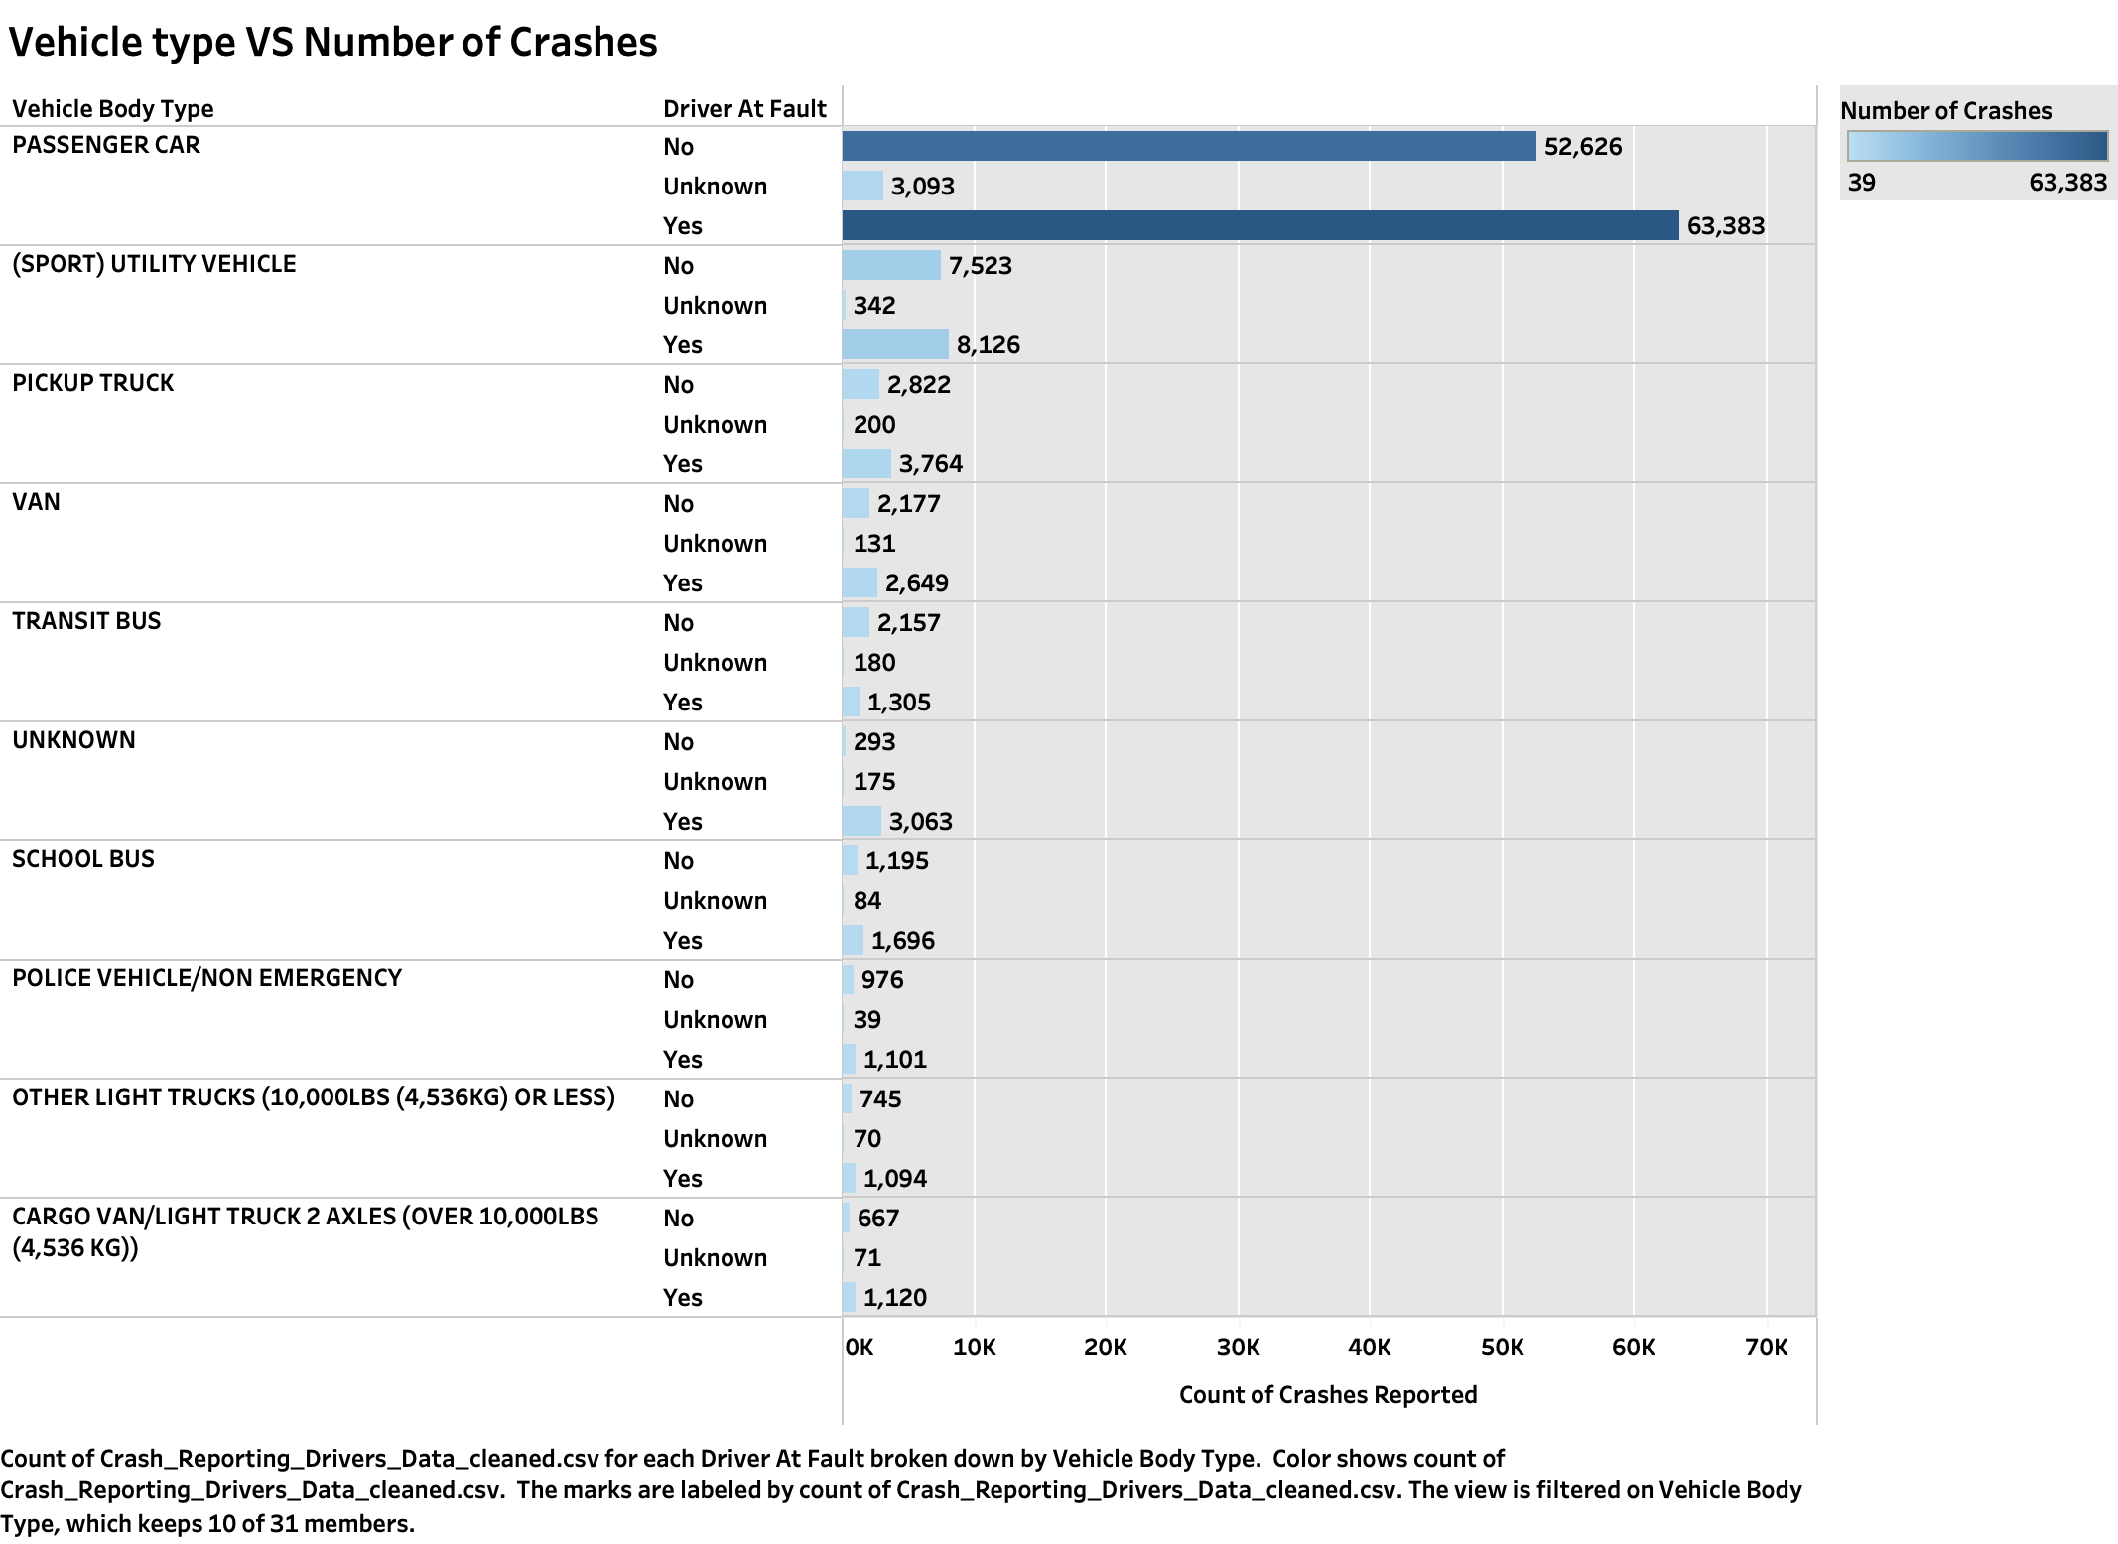

Slide 18
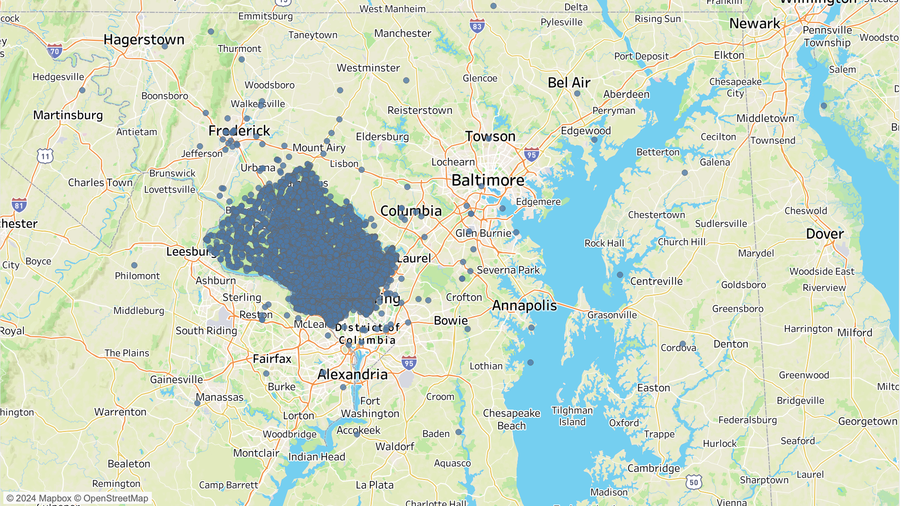
Geospatial Analysis
What are the primary locations or areas within MD, where car accidents tend to occur?

Slide 19
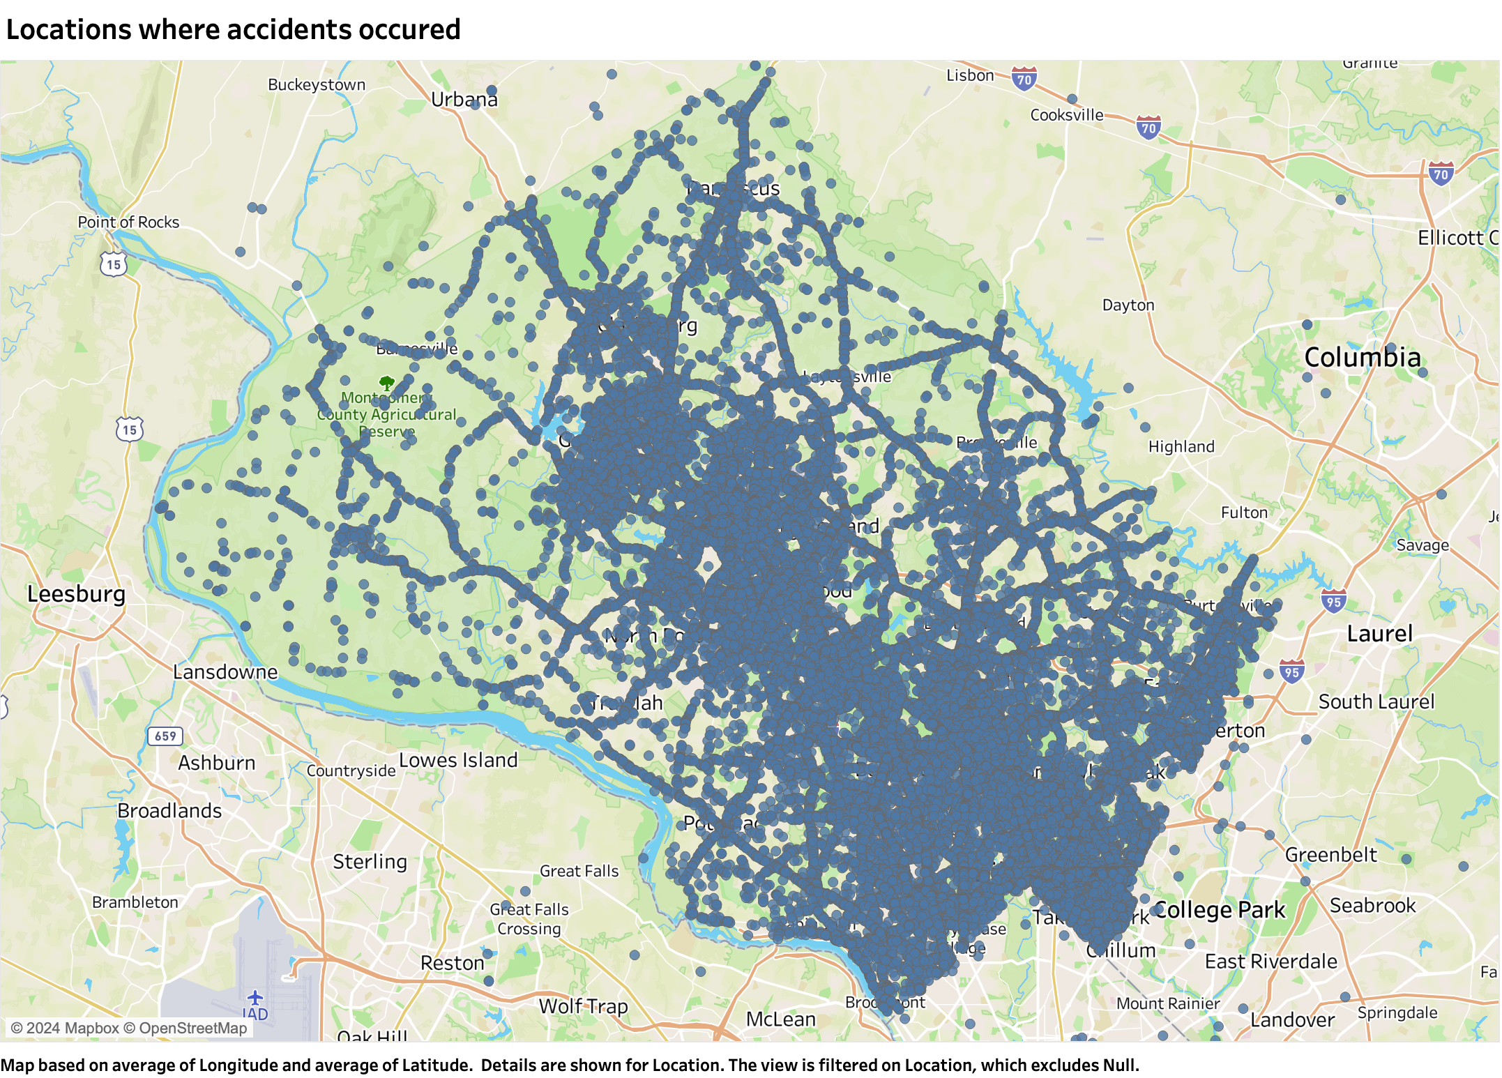

Slide 20
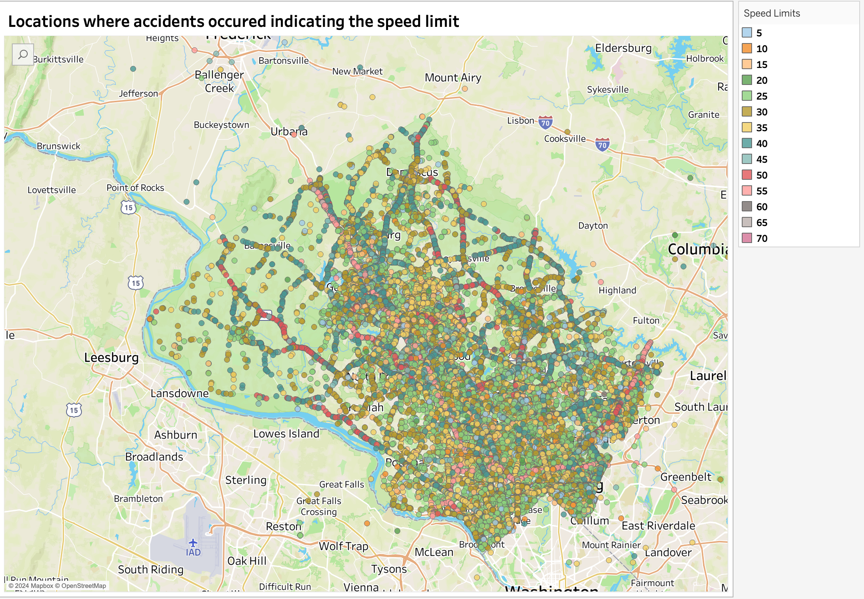

Slide 21
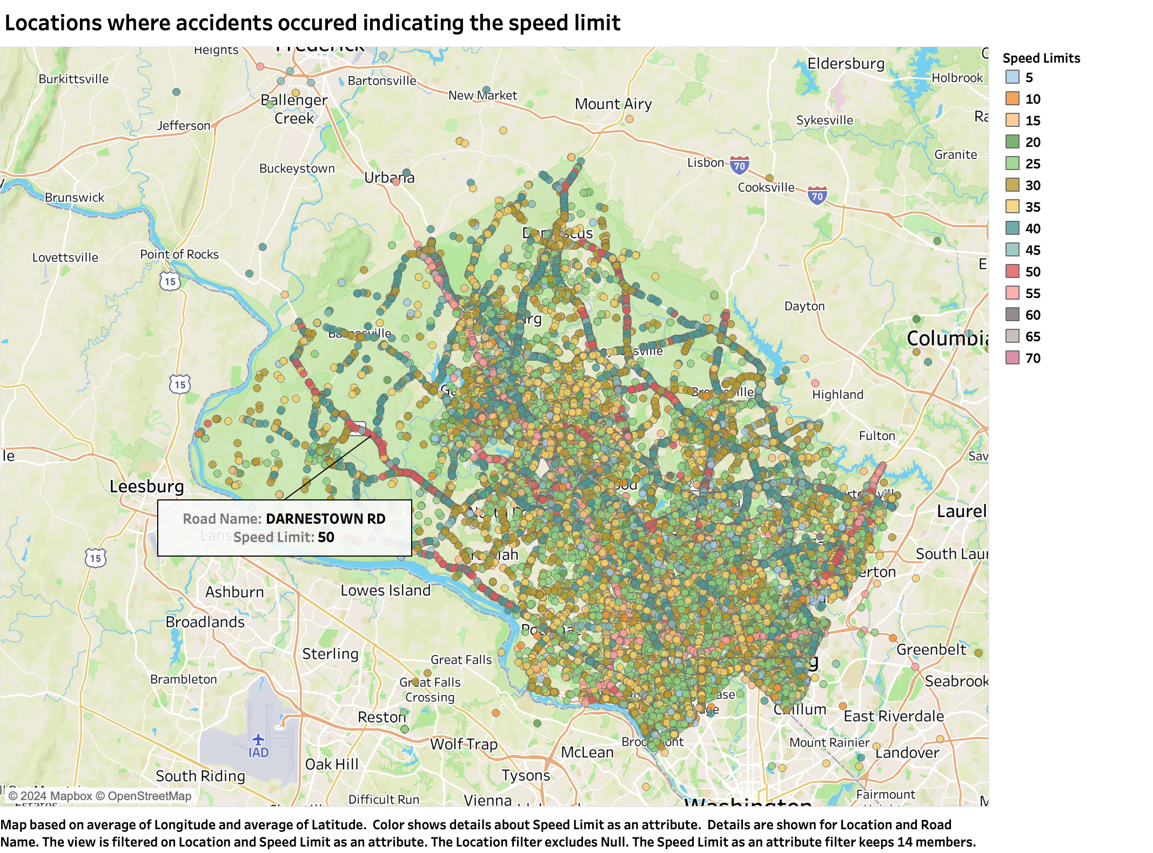

Slide 22
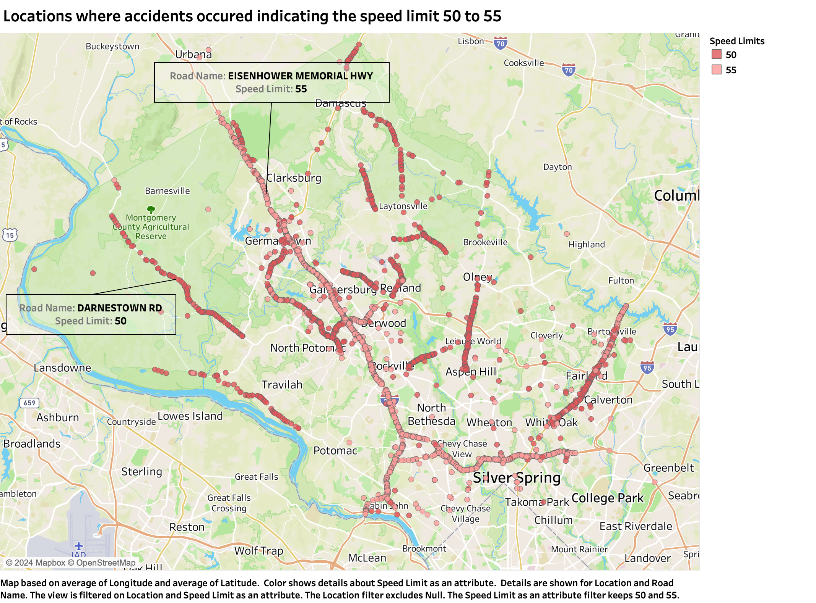

Slide 23
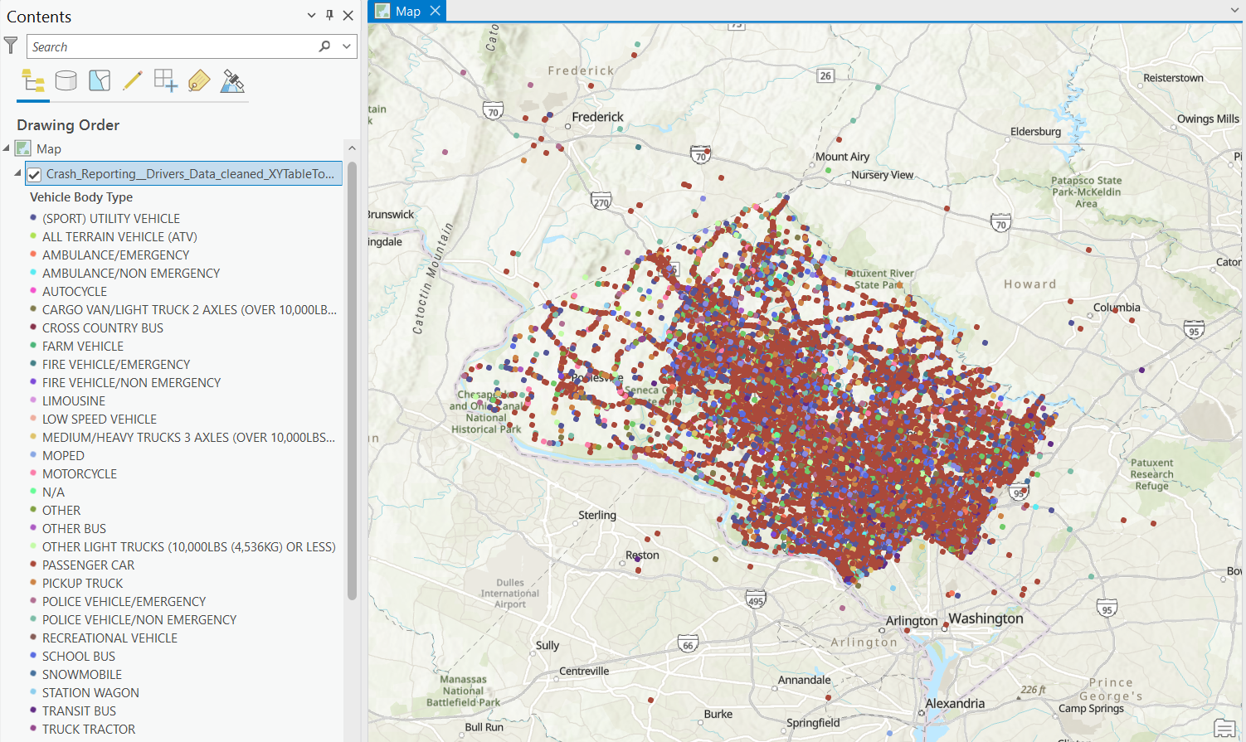

Slide 24

Connecting Mongodb and Databricks
Install Mongodb compass in your system
Create a free cluster in mongodb atlas using the try free version
Connect compass and atlas using a connection string
Using the network access in atlas add the 0.0.0.0/0 IP address to allow any third-party application to connect to atlas
In databricks create a cluster and install the mongo-spark library to connect to mongodb using pyspark
Now you can connect databricks to mongodb database and collection using a simple code.

Slide 25
Feature Engineering
Feature engineering steps:
Load the data from Mongodb by connecting with the database and cluster using pyspark.
Clean the data for fitting it to the further steps (replace certain columns with means and modes etc.).
Split the data into training set and test set.
Use string indexer to and one hot encoder functions.
Then new columns with indexes for the categorical columns are created
Visualize the original columns against index columns to analyze which categories of each column appear frequently in the data.
Build pipeline using the string indexer, encoder and vector assembler and use this pipeline to build machine learning models.

Slide 26
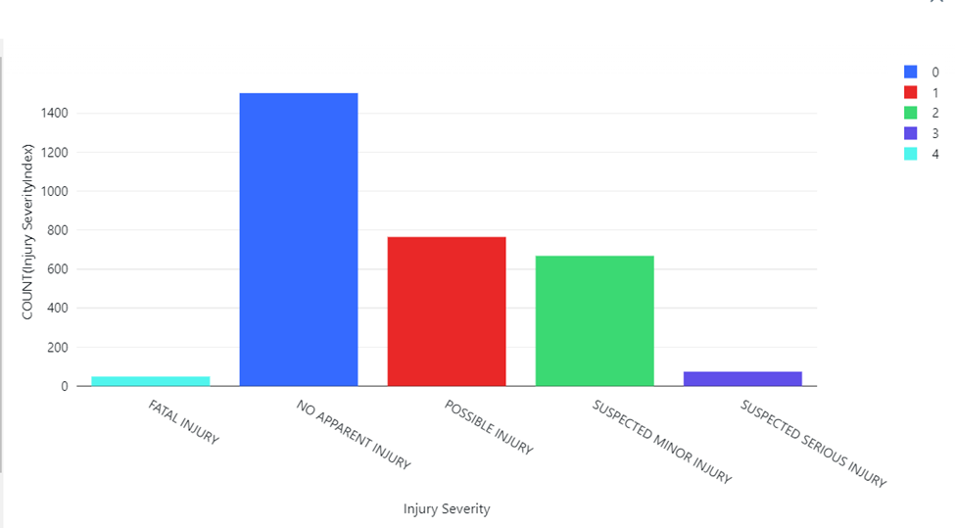
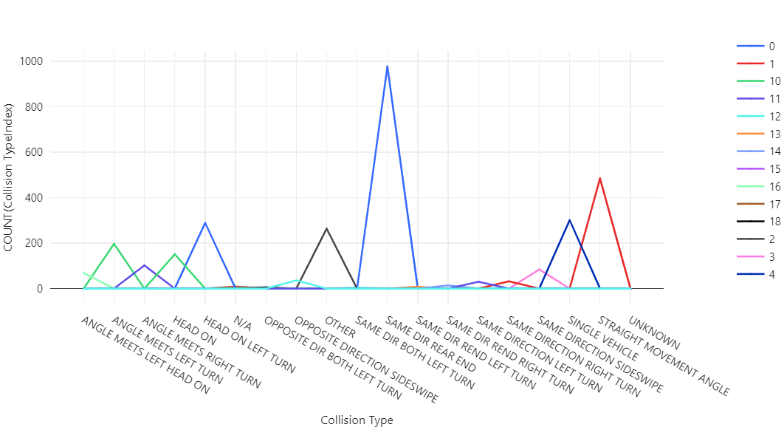
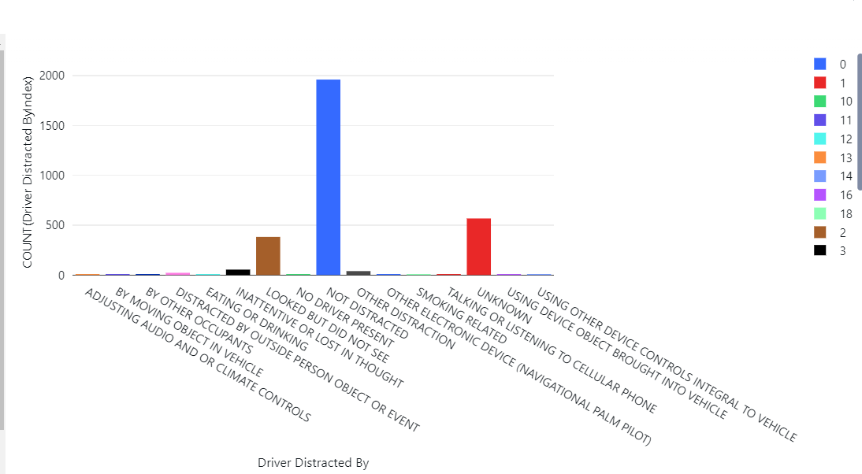
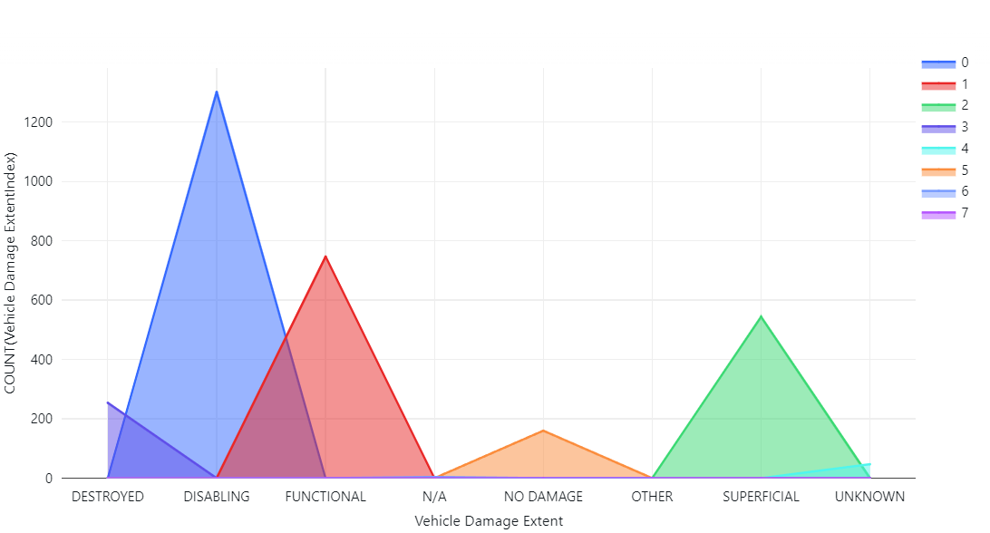
Feature Engineering Outputs

Slide 27
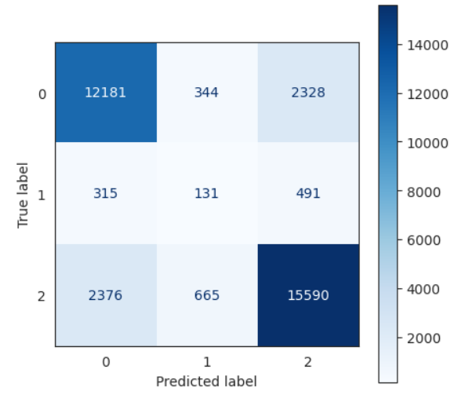
Model Evaluation
Decision Tree

Slide 28
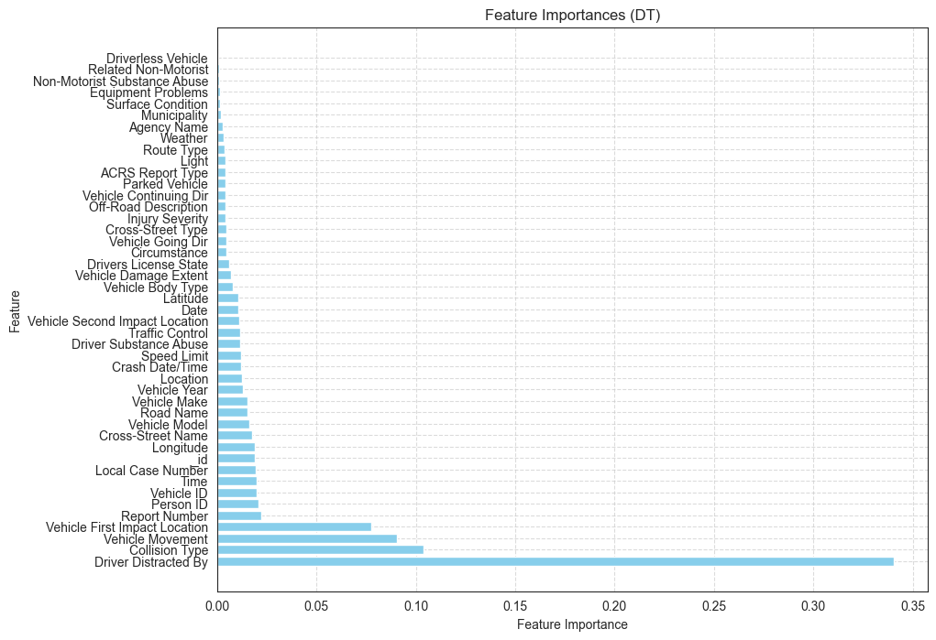
Model Evaluation
Decision Tree

Slide 29
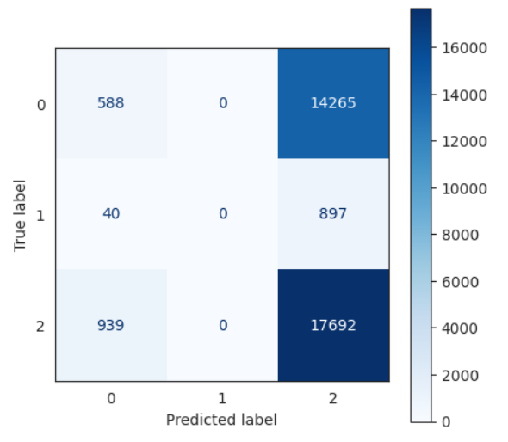
Model Evaluation
Logistic Regression

Slide 30
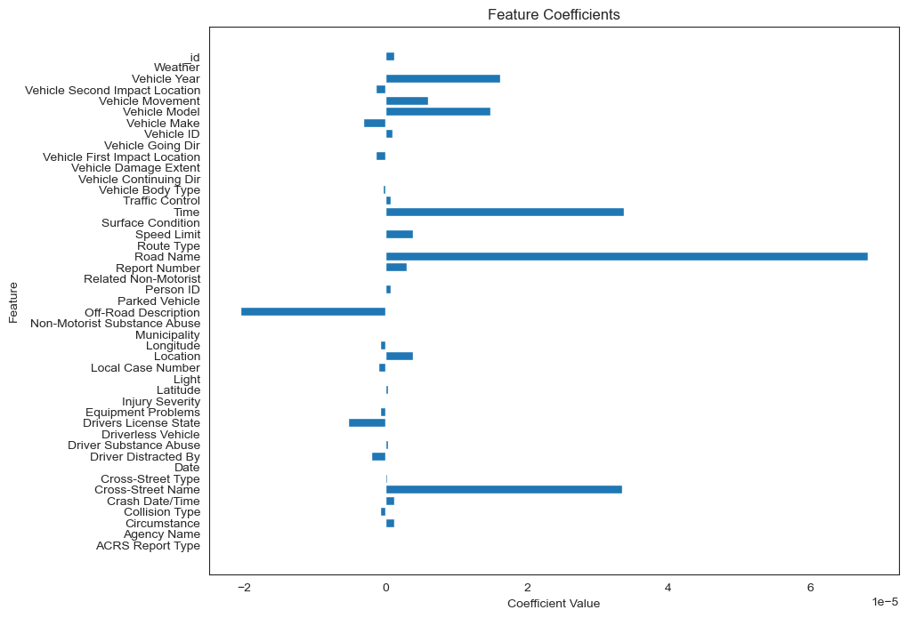
Model Evaluation
Logistic Regression

Slide 31
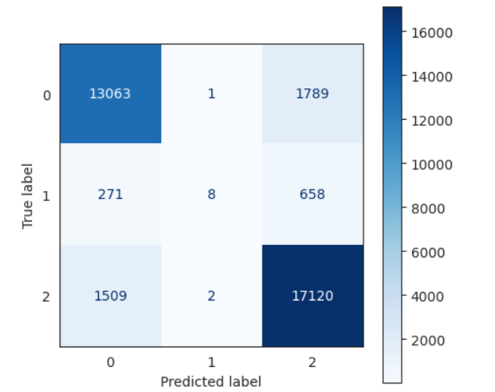
Model Evaluation
Random Forest

Slide 32
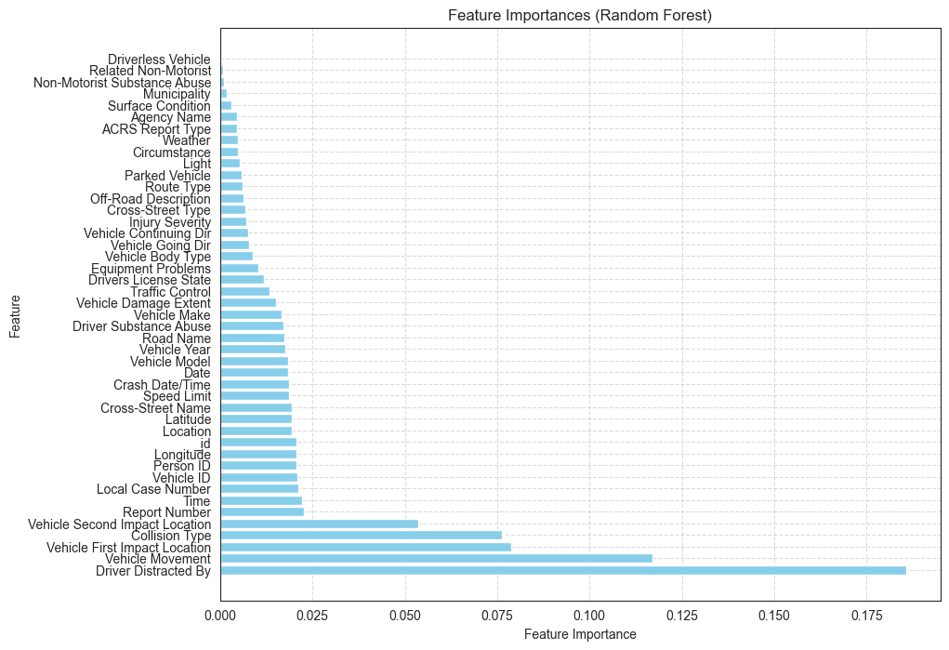
Model Evaluation
Random Forest

Slide 33
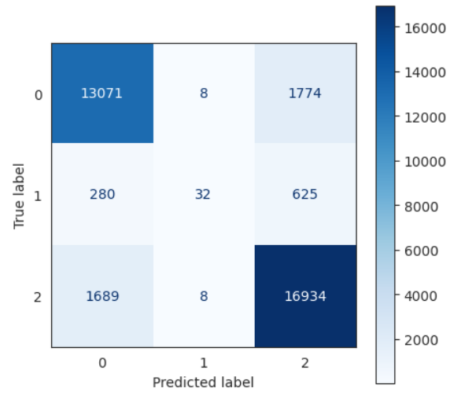
Model Evaluation
Gradient Boosting Classifier

Slide 34
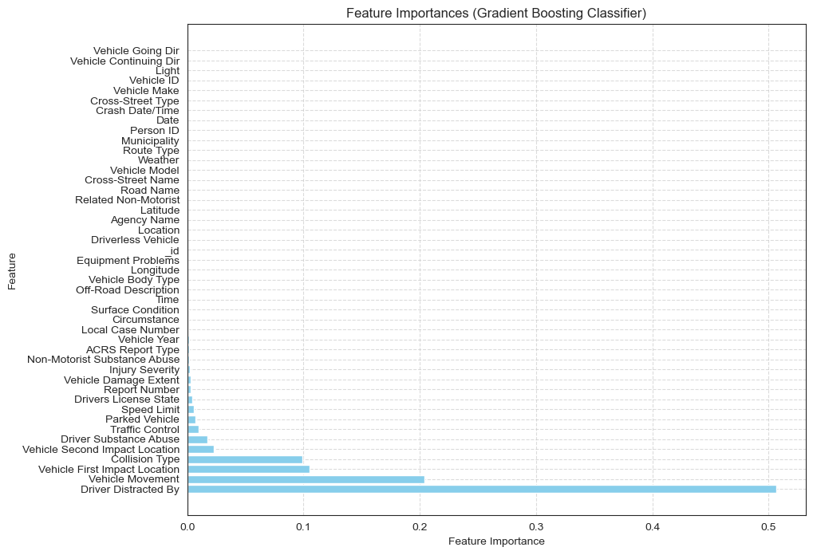
Model Evaluation
Gradient Boosting Classifier

Slide 35
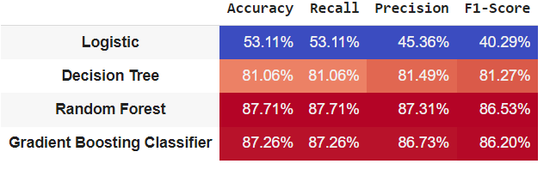
Machine Learning Model Outputs
These are the output for the 5 different models that we used for our predictions.
Random forest performed the best with an accuracy of 87.71% and the least was Logistic Regression with an accuracy of just 53.11%

Slide 36
Results
Primary factors for predicting driver at fault include Vehicle Movement, Driver Distractions, Collision Type, First Impact Location, and Second Impact Location.
Out of five predictive models tested, the Random Forest model outperformed others with the highest accuracy of 87.71%.
The Random Forest model is identified as the most appropriate and accurate model for these predictions.

Slide 37
Conclusion
In our analysis, the RandomForest classifier emerged as the optimal model for our predictive task, showcasing superior performance and leveraging the most pertinent features to predict outcomes effectively. Throughout our evaluation, RandomForest consistently outperformed alternative models, demonstrating higher accuracy, precision, recall, and F1-score metrics. This robust performance underscores the efficacy of RandomForest in capturing the underlying patterns within our dataset and making accurate predictions.

Slide 38
Project timeline
Task | Timeline
Project Proposal - All team members | March 6th – March 12th
Data Cleaning and Storage - Peiran Li | March 13th - March 19th
Feature Engineering - Naga Sai Dhanya Veerepalli | March 20th - March 23rd
Exploratory Data Analysis - Zeeshan Khalid | March 24th – March 31st
Machine Learning Algorithm, Metrics Evaluation & Performance Evaluation – Siddharth Sajjasningh Sandu | April 1st – April 7th
Geospatial Analysis- Akhila Kudupudi | April 8th – April 10th
Finalization & Documentation. Final adjustments to the model and preparation of project documentation for submission. - All team members | April 10th – April 15th

Slide 39

Thank you

